Slide 1



QUOTE MANAGER
ORGANIZE & INSPIRE

Slide 2
PROJECT OVERVIEW
A C++ program to manage motivational quotes.
Allows users to add, view, search, delete, and sort quotes
Helps organize inspirational content efficiently in CLI format

Slide 3

TECH COMPANY
Insert new quotes with author and date
Display all saved quotes
Search by keyword or author
Delete specific quotes
Sort quotes by date (ascending)
Color-coded terminal for better UX
KEY FEATURES

Slide 4

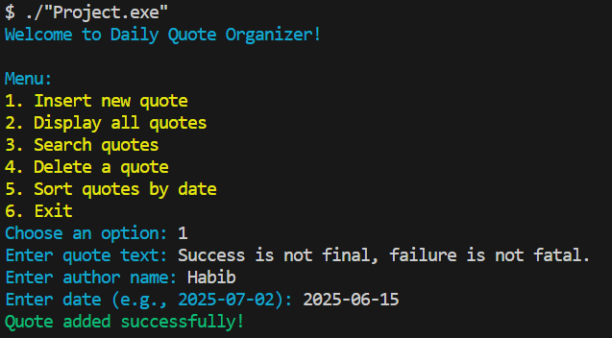

INSERT NEW QUOTE

Slide 5
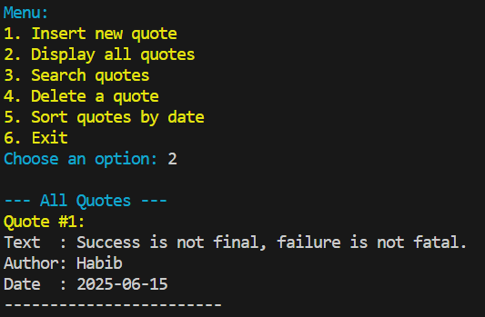
DISPLAY ALL QUOTES

Slide 6
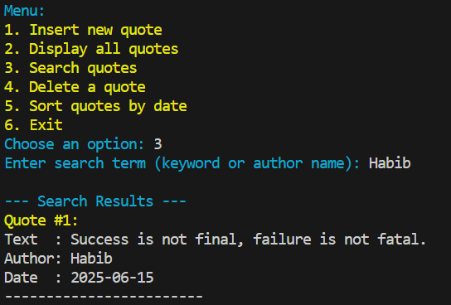
SEARCH QUOTES

Slide 7
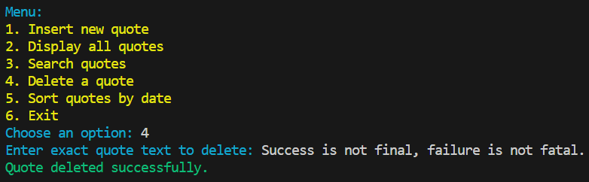
DELETE A QUOTE

Slide 8
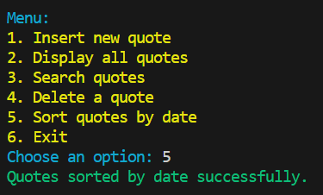
SORT QUOTES BY DATE

Slide 9
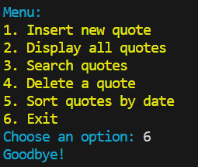
EXIT

Slide 10
TECH COMPANY
FUTURE SCOPE
01
02
03
Component Research
File saving/loading support
Use of vector for dynamic storage
Random quote of the day feature
Designed a user-friendly terminal interface

Slide 11
CONTACT US
E-mail
e241024@ugrad.iiuc.ac.bd
Website
www.pending.com
Phone
+8801329453598
Address
123 Anywhere St., in Bangladesh

Slide 12



TEAM
TECH COMPANY
Rohit Ahemed
Md.Habibur Rahman
Saimon Uddin Imam
E241013
E241024
E241014

Slide 13
COURSE CODE: CCE-2302
COURSE TITLE: DATA STRUCTURE AND ALGORITHMS SESSSIONAL
THANK YOU

